Slide 1
Mangroves

Slide 2
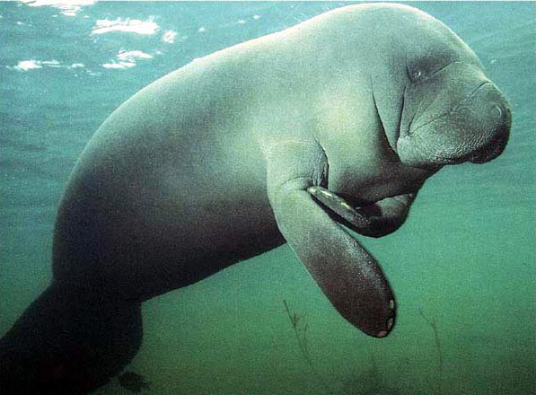
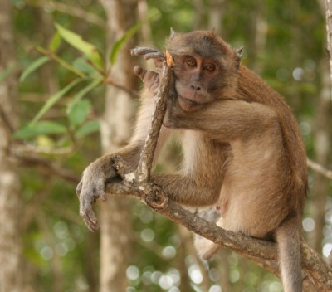
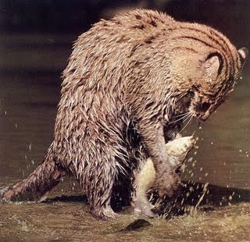
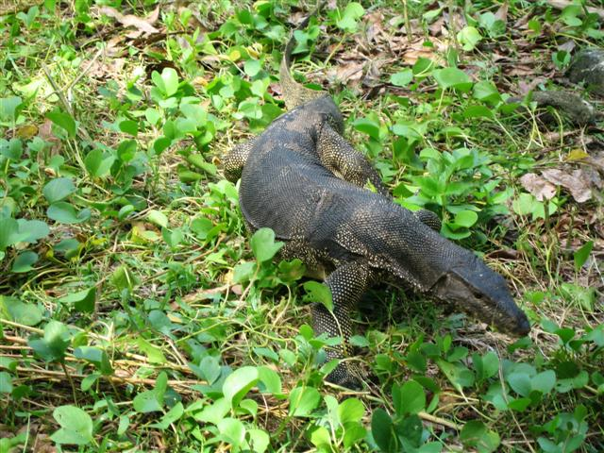
Why are Mangroves so special?
Muddy, mosquito and crocodile infested mangroves are not a very inviting place
The forests provide a habitat for a huge selection of plants and animals, both marine and terrestrial.
Manatee Crab Eating Monkey Fishing Cat Monitor Lizard

Slide 3
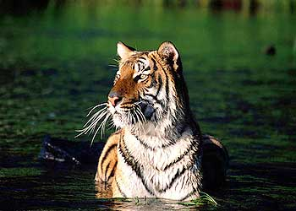
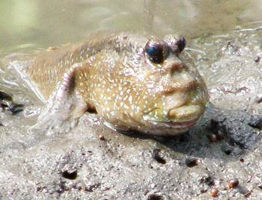
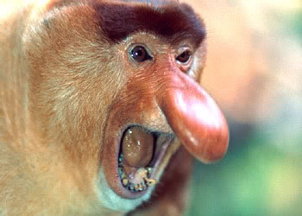
Mangroves are essential to marine, freshwater and terrestrial biodiversity.
They stabilise coastlines against erosion
Collect sediments
Provide a nursery for coastal fish
Royal Bengali Tiger Mud Skipper Fish Proboscis Monkey

Slide 4
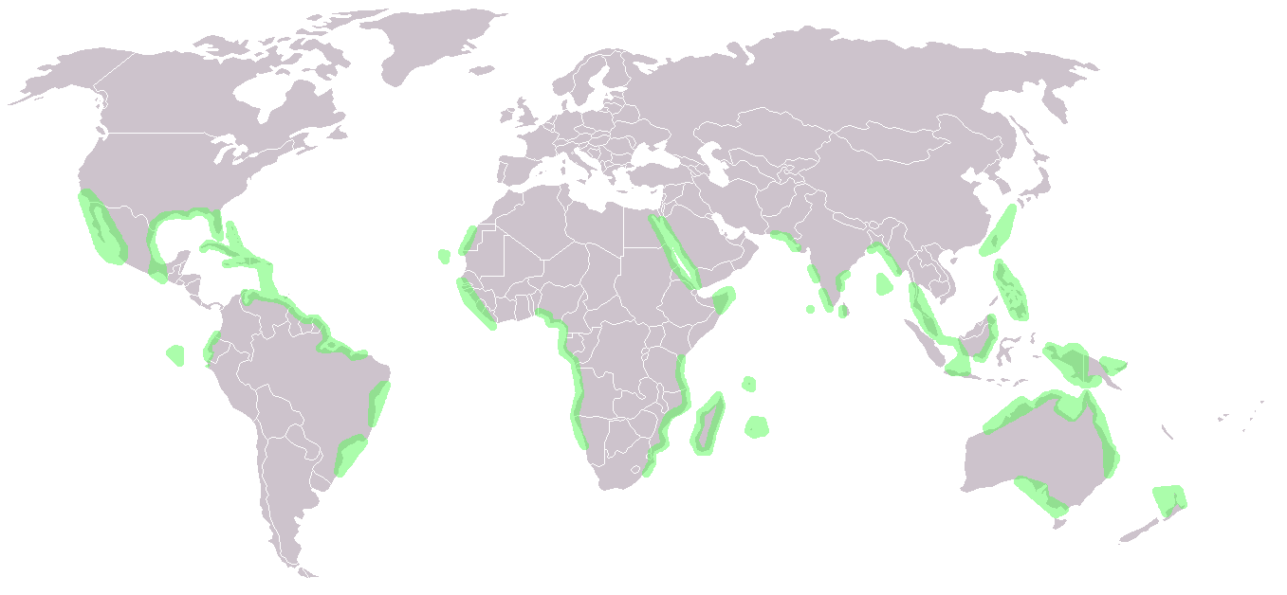
Where are they Located
Copy this map onto your own blank map
Draw on the map the tropics and the Equator

Slide 5
Where to they Thrive
They grow in inter-tidal areas and estuary mouths
They are found along the tropics and sub tropical coasts of Africa, Australia, Asia and the Americas
SE Asia contains Mangroves of the greatest diversity

Slide 6
Video
Please make notes on the following video

Slide 7
Sundra Shelf Mangroves
Found on the island of Borneo on the east coast of Sumatra
Covering 37,400km²
Fall within the Sundaland Wetlands hotspot
Considered to be one of the most diverse in the world (Endemism and species richness is not specifically great)

Slide 8
Facts
Five major mangrove types are grown here, with differing soils, salinity and tidal movements
Over 250 bird species are found in this eco-region, but many are transient or migrant
Mangroves are home to the proboscis Monkey one of the few large mammals limited to Mangrove and peat swamp forest habitats and are now threatened with extinction.

Slide 9
Mangroves are found where average temperatures are above 20º C
Where shorelines are protected by the full force of oceanic waves (Coral Reefs)
Depositional shorelines

Slide 10
Activity – Where do they grow?
They grow in areas
Permanently waterlogged soil that are starved of oxygen (Anaerobic)
High Salinity
Frequently flooded
Intense sunlight and hot weather
Limited supply of freshwater

Slide 11
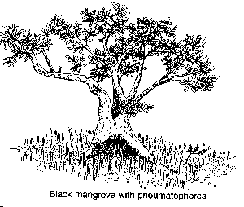
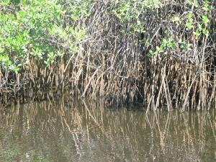
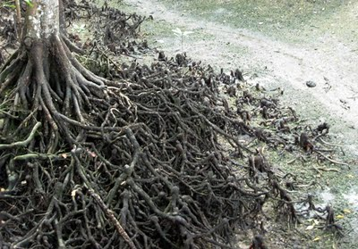
Vegetation
Vary in height from shrubs to 40m trees
Prop roots aid stability
Pneumatophores – roots rising from the soil above the stem and water level (breathe both water and air using pores called lenticels)

Slide 12
Zonation
Zonation refers to when certain species occupy particular areas or niches in the ecosystem.
They are distinguished by the levels of salinity, waterlogging, and amount of sediment available
RED, BLACK and WHITE/GREY mangroves

Slide 13
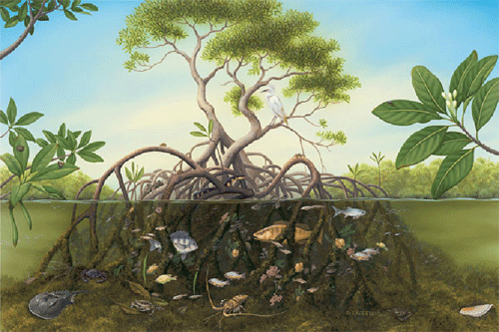
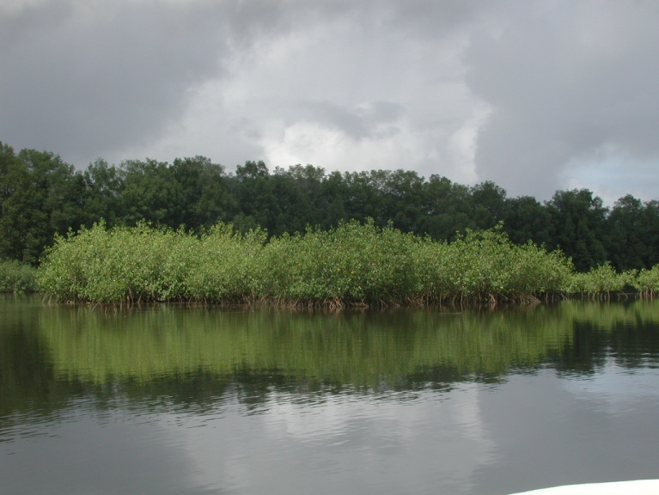
Red Mangroves
Found closest to the coast
Take the brunt of wave action
Survive permanent waterlogging

Slide 14
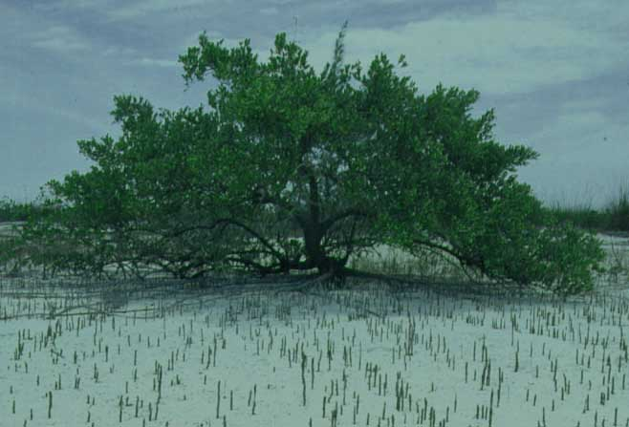
Black Mangroves
Survive further inland
Protected by red mangrove
They have Pneumatophores with lenticels to obtain oxygen would die if permanently waterlogged

Slide 15
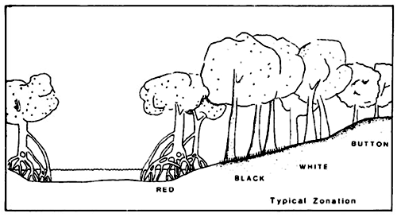
White/Grey Mangroves
Found furthest inland
Least able to survive waterlogging
Cross Section of a Mangrove Forest

Slide 16
Productivity
These can be nearly as productive as tropical rainforests
The mud is a critical role as a nursery for the sea’s fish, shrimp larvae, crabs and crustacea
A teaspoon of mud from a north Queensland mangrove contains more than 10 billion bacteria
This is a great indication of the incredibly high productivity

Slide 17
Goods
Timber (Wood)
Firewood, charcoal, poles, chips
Other Plant Products
Nipa thatch, sugar, alcohol, honey
Animal Product
Fish (fin & shell)

Slide 18
Services
Nursery/Breeding Grounds
Bird Sanctuary/Migratory Stops
Maintenance of Channel Depth
Coastal protection?
Carbon sequestration
Ecotourism

Slide 19
Putting a value on Mangroves
Intact mangroves provide an economic value of at least $1,000 a hectare rising possibly to $36,000
Converting mangroves to aquaculture for the purpose of shrimp farming as in Thailand might make short term economic sense but cleared mangroves make only $200 a hectare

